Slide 1
Object Oriented Programming Project 4
Team 7
Valentin Kiryk
Vincent Choquet
Seray Ayakta

Slide 2
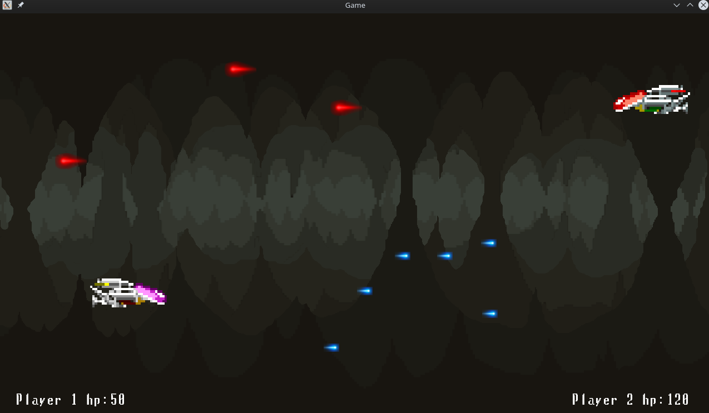

Presentation

Slide 3



Shared Libraries(.so) as PLUGINS
Weapons
Loaded at the start of the program (run time)
Flexible
Easy to update / modify / debug
Faster to compile
Reduce the size of the executable program
Change content of the game without changing a line of code.
Spaceships
(Players)
Maps
(Background)

Slide 4




Development Tools

Slide 5
DEMO

Slide 6
Thank you for listening !

